Slide 1
Builder
Team 11

Slide 2
Builder
The builder design pattern is a type of creational design pattern.
Creational design patterns solve problems related to object creation.

Slide 3
Motivation
Have a complex object that can be created with many parameters (some are mandatory, others are optional)
Want to reduce the number of parameters to a constructor, increase design flexibility, code readability.

Slide 4
Intent
Abstract away the construction of a complex object so that many different representations can be created from same construction process
Parse a complex representation and create one of several target products.

Slide 5
Discussion
Separate algorithm for parsing and reading from algorithm for building and representing target products
Have a director that invokes builder services which create parts of complex object each time it is called and maintains all intermediate states

Slide 6
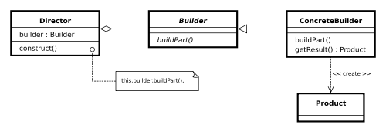
Components

Slide 7
Components
Director: Construct complex object using Builder interface
Builder: Specify interface for creating product
Concrete builder: Assembles parts of product by implementing builder interface
Product: Complex object that is being built

Slide 8
Example
Object: Canadian Address

Slide 9
Example (Step 1)
In the following implementation CanadianAddress has two responsibilities:
responsible for both parsing strings representing Canadian addresses
representing a Canadian address.
Should only have one!

Slide 10
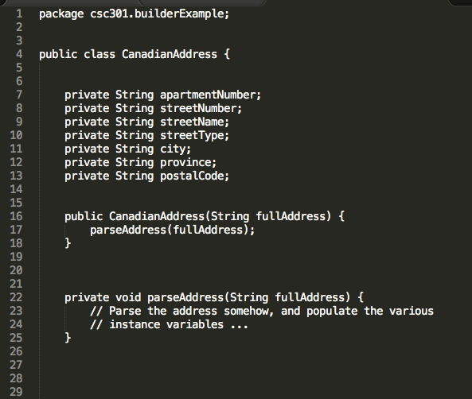
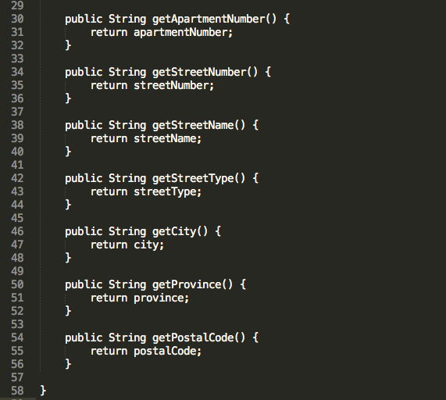
Example (Step 1)

Slide 11
Example (Step 2)
In next implementation, CanadianAddress has only one responsibility but the constructor has too many arguments and all of same type.
Developers need to remember order of arguments every time code is modified.
Result: Slows down developers and more error prone code

Slide 12
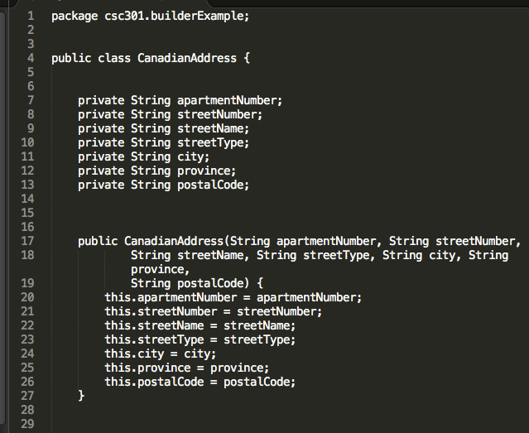
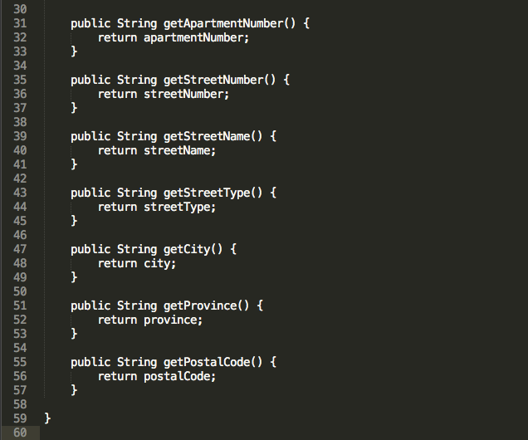
Example (Step 2)

Slide 13
Example (Step 3)
In next, no more telescoping constructor problem
provided default constructor (0 arguments)
setters for all properties
New problem: too easy to create invalid/illegal instances. Should throw exception if constructor is provided with invalid arguments

Slide 14
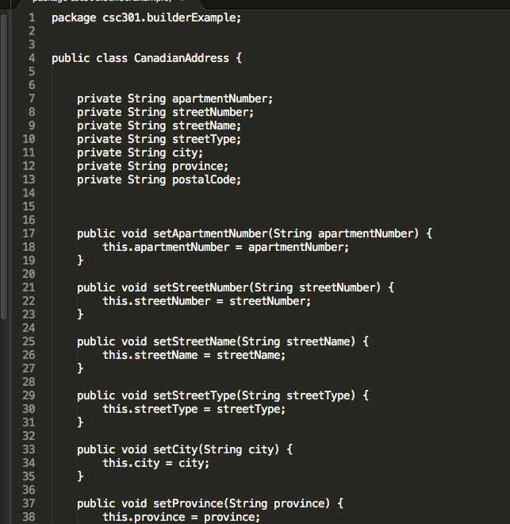
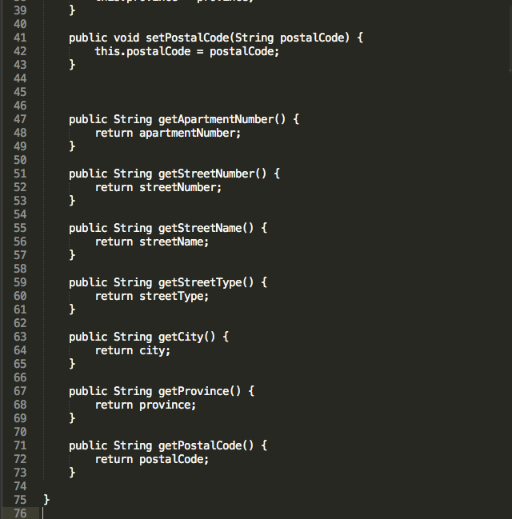
Example (Step 3)

Slide 15
Example (Step 4)
In next implementation, we introduce the CanadianAddressBuilder class which separates argument collection and creation of instance of CanadianAddress
Problem: Want to prevent the ability to directly create new instances using “new CanadianAddress()”

Slide 16
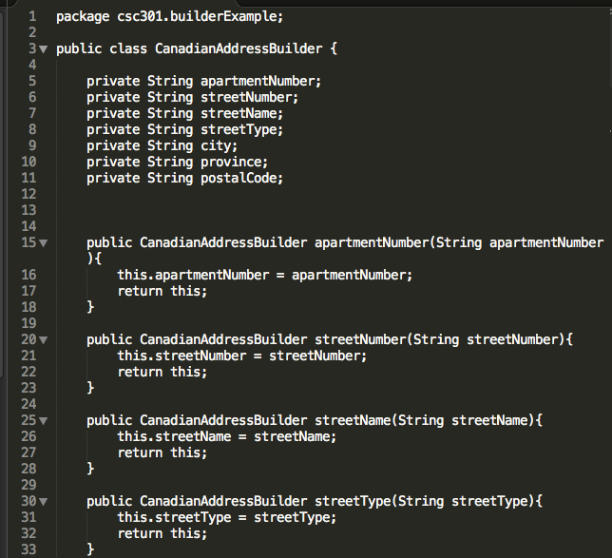
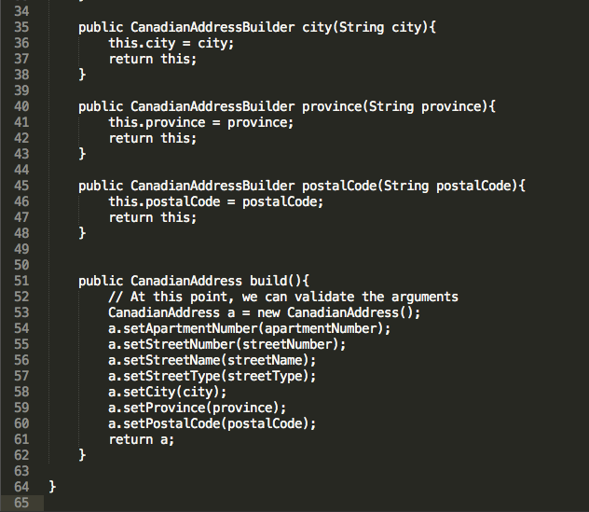
Example (Step 4)

Slide 17
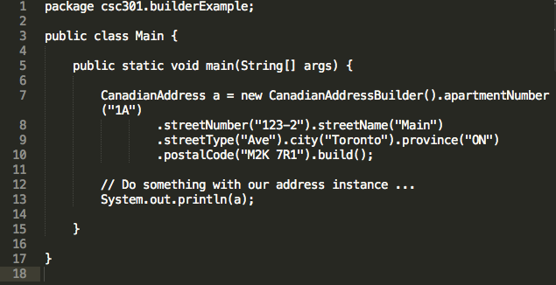
Example (Step 4 Cont.)

Slide 18
Example (Step 5)
Builder class inside CanadianAddress class
Changed constructor of CanadianAddress to be private and takes single argument of type CanadianAddress.Builder
Cannot create new instances of CanadianAddress since constructor is private
Can validate arguments inside build method

Slide 19
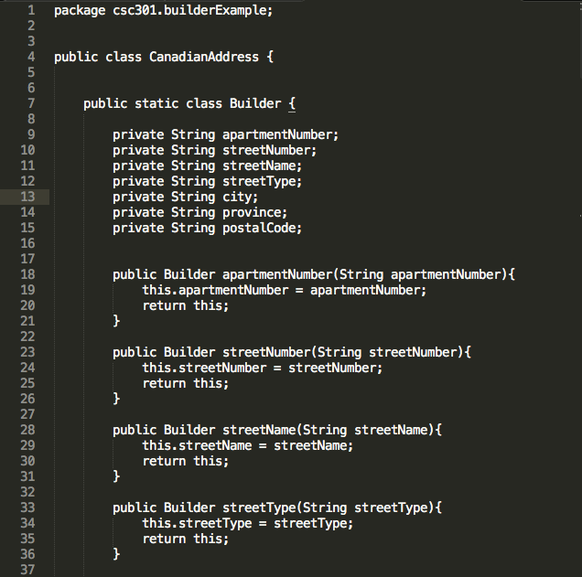
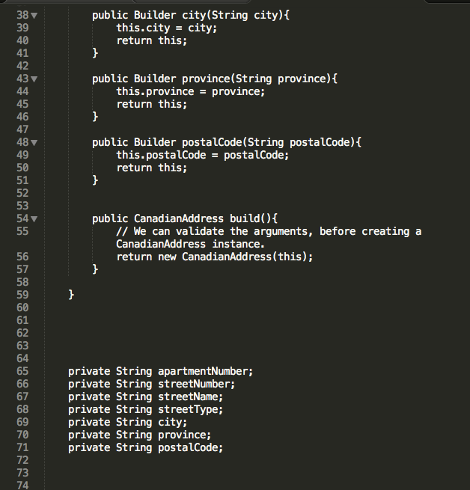
Example (Step 5)

Slide 20
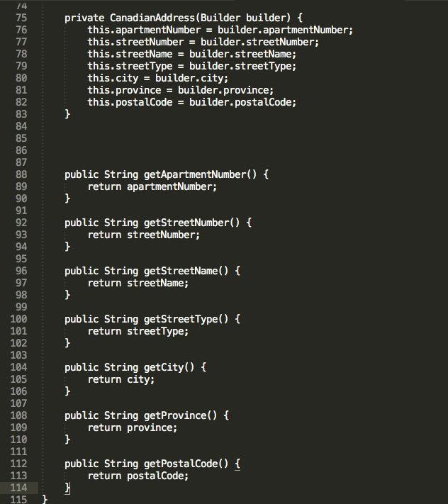
Example (Step 5 Cont)

Slide 21
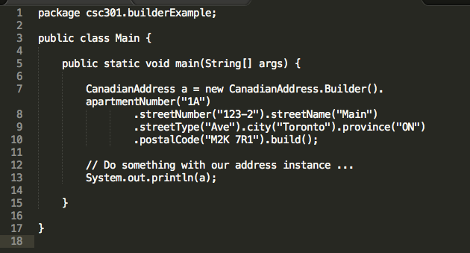
Example (Step 5 Cont)

Slide 22
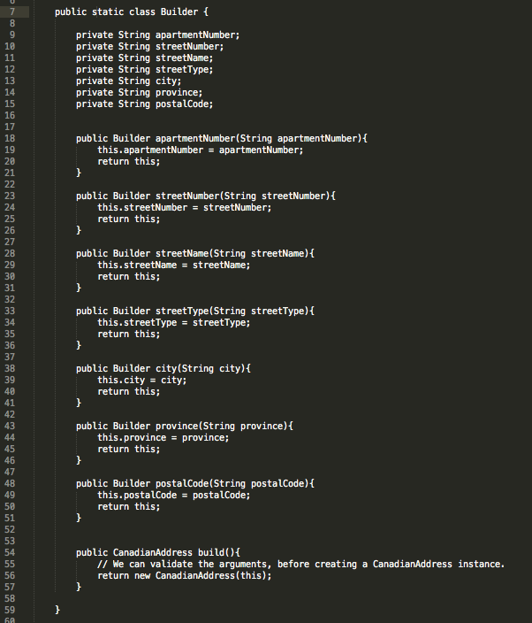
Example (Complete, Builder Class)

Slide 23
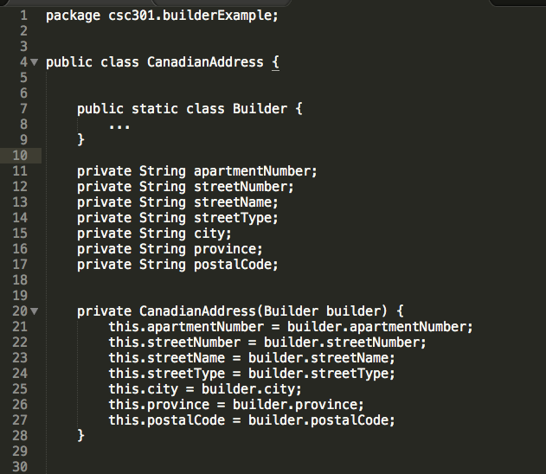
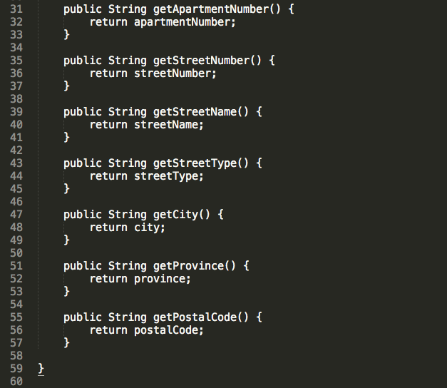
Example (Complete, Canadian Address Class)

Slide 24
Conclusion
Final notes on Builder Design Pattern

Slide 25
Conclusion
The builder design pattern builds complex objects step by step and returns a product at the end.
Use when you have complex object with common input and many possible representations

Slide 26
THE END

